Slide 1
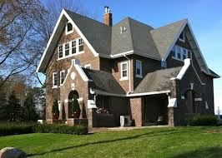
Iowa House
Price Prediction
Team: 3NN

Slide 2
Outline:
EDA
Data cleaning
Missingness imputation
Outlier
Dummification
Feature engineering
Pre Model
Cross Validation - find best hyper parameter
Reduced model
Model

Slide 3
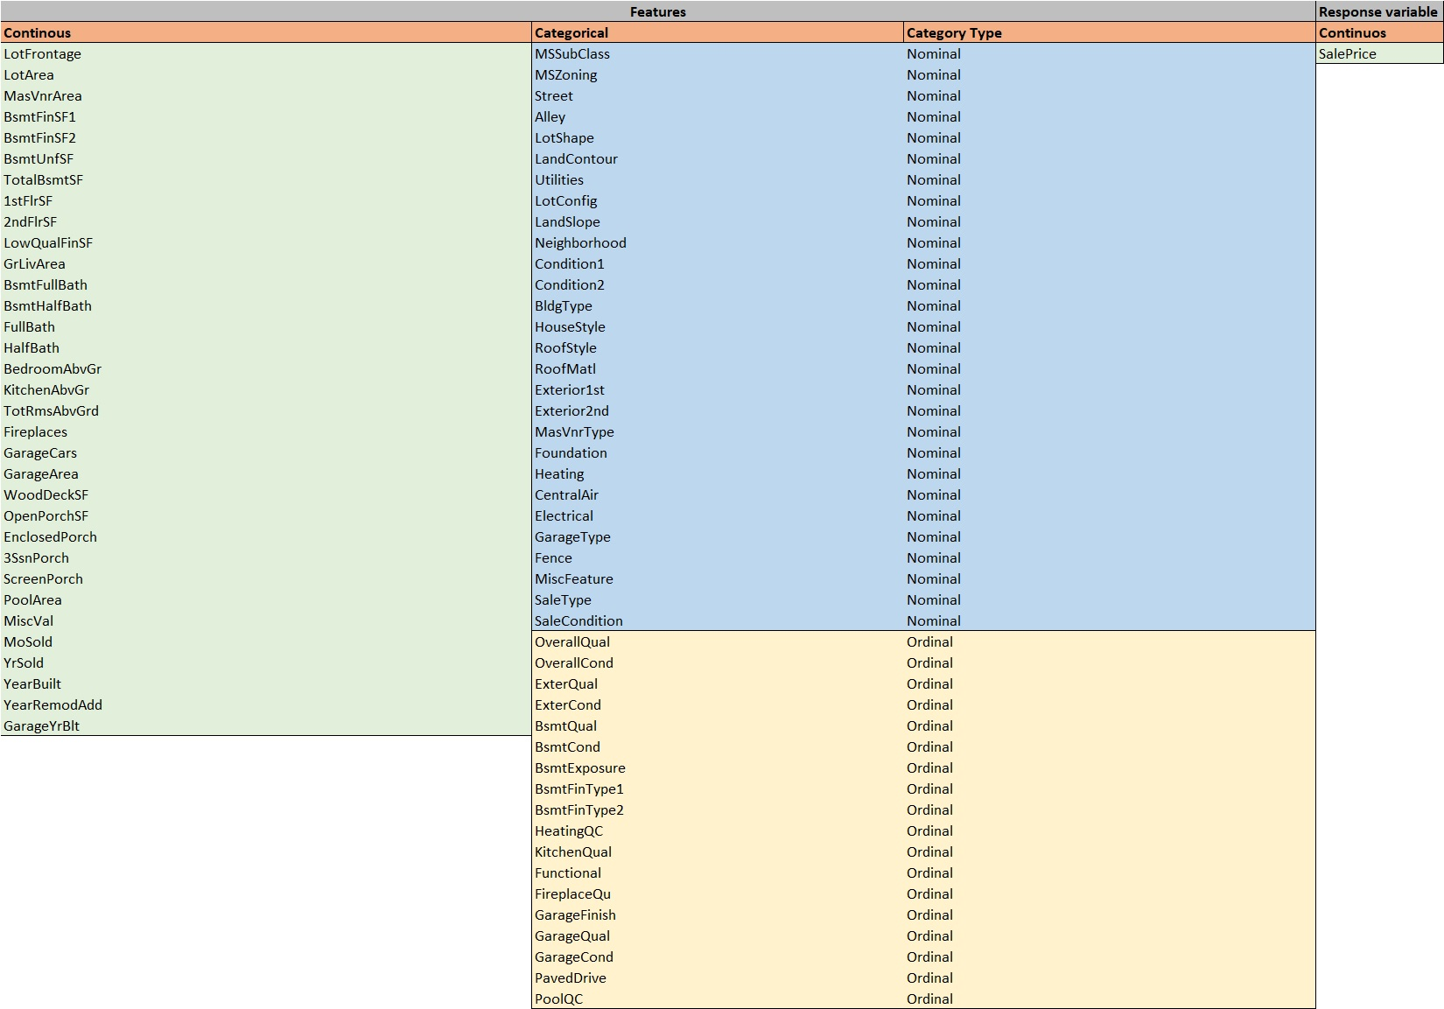
Data Exploration

Slide 4
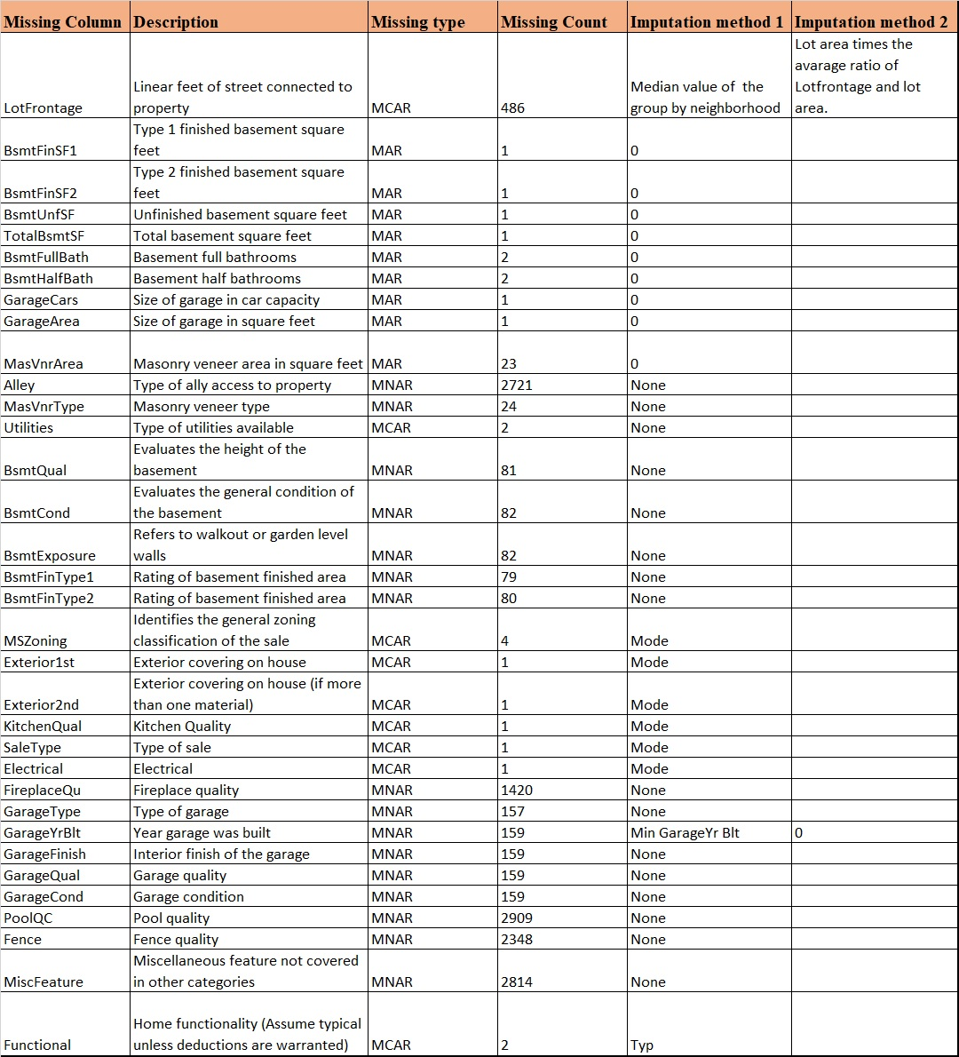
Data Cleaning - Missing data imputation:

Slide 5
Exploratory Data Analysis (EDA)
Correlation plot
Numerical data hist
Categorical data boxplot
Distribution (Transformation)
Multicollinearity

Slide 6
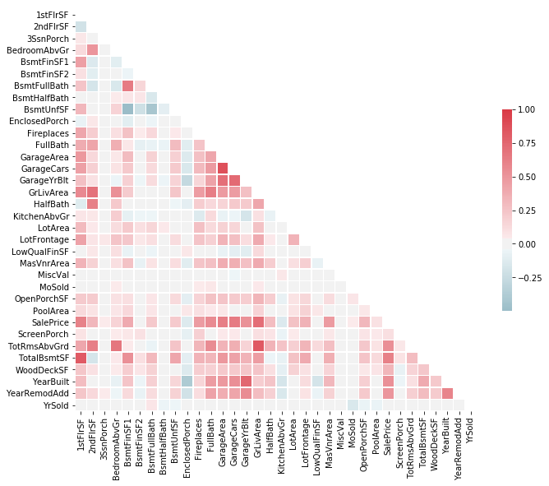
Correlation plot
Columns | Correlation
GrLivArea | 0.708624
GarageCars | 0.640409
GarageArea | 0.623431
TotalBsmtSF | 0.613581
1stFlrSF | 0.605852
TotRmsAbvGrd | 0.533723
FullBath | 0.560664

Slide 7
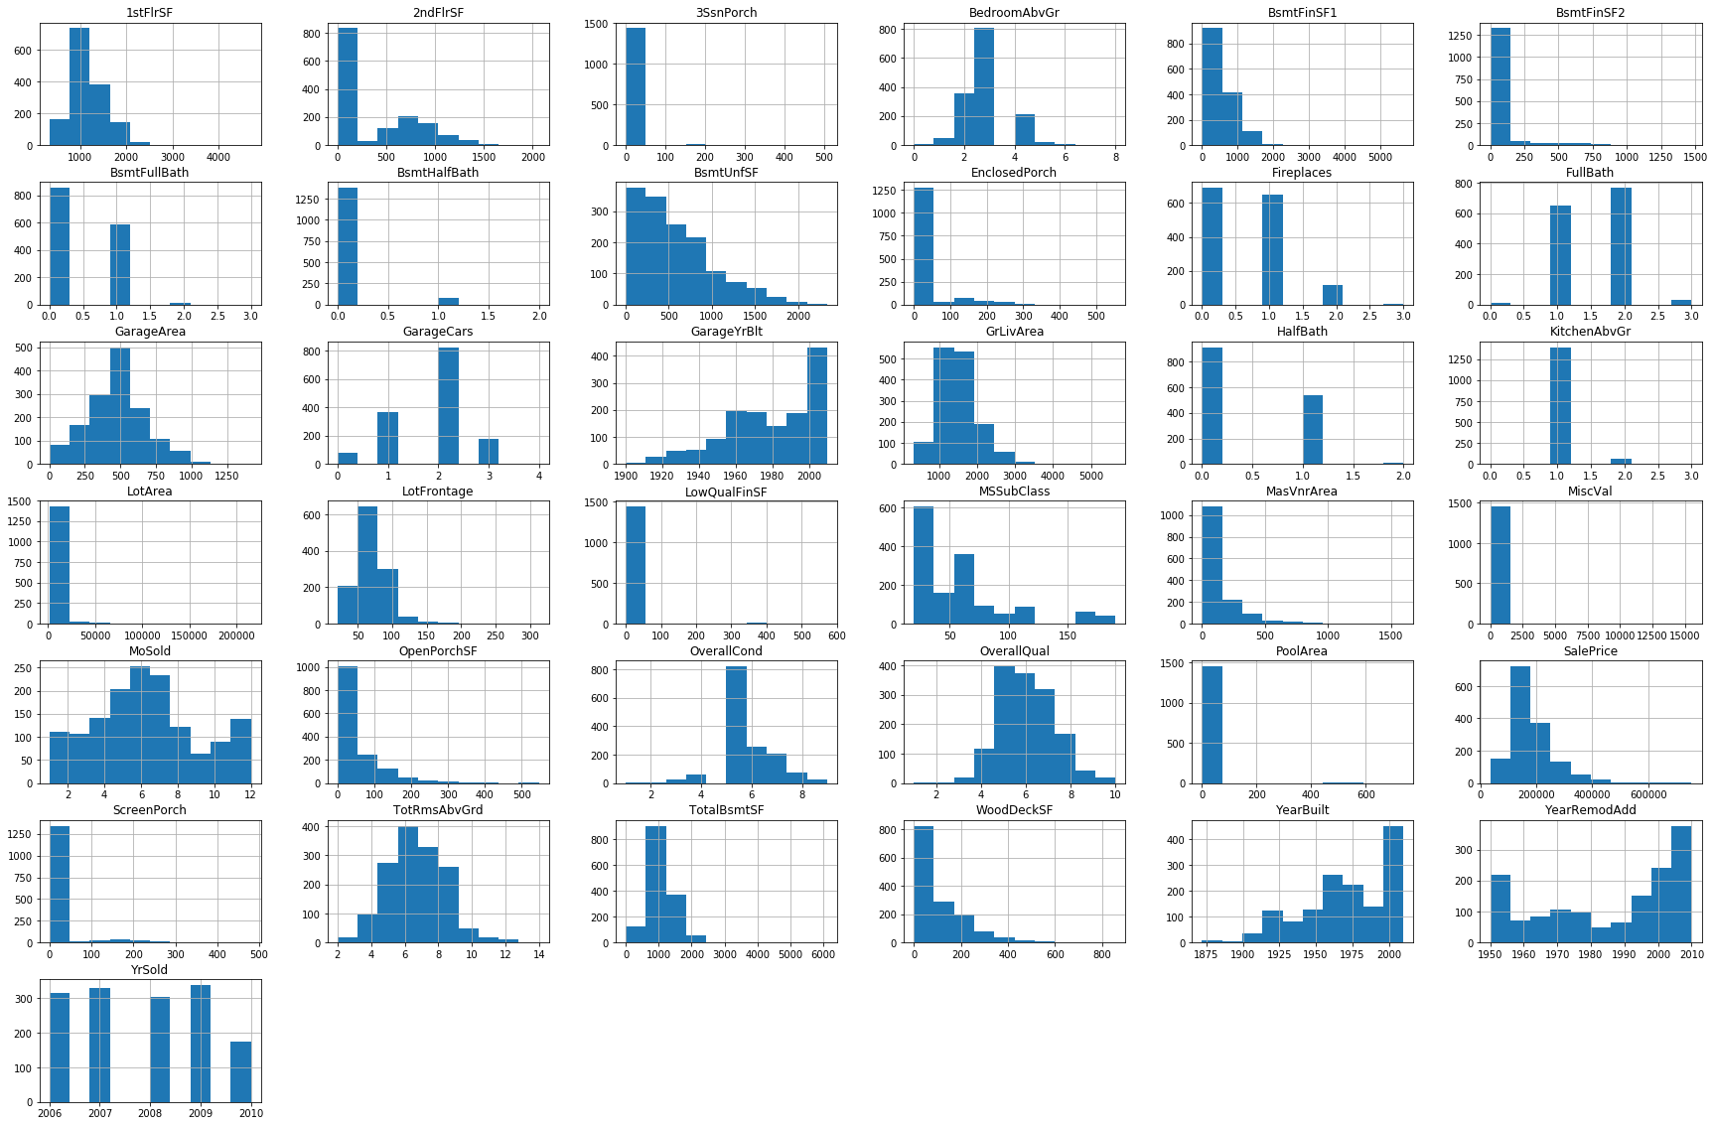
Numerical variables histogram

Slide 8
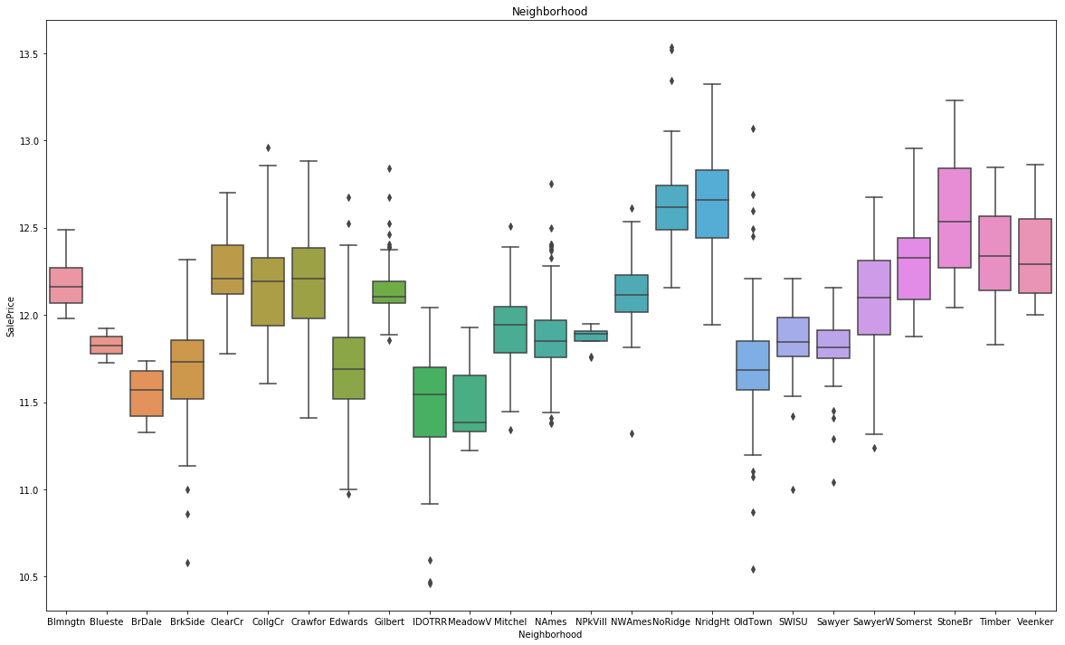
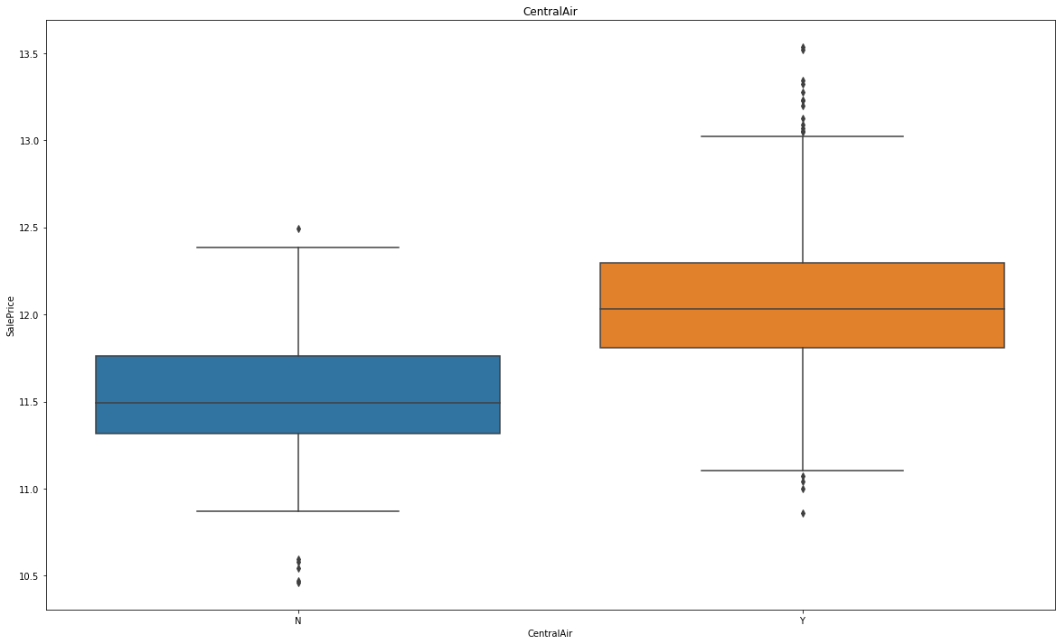
EDA - Categorical data vs price boxplot

Slide 9
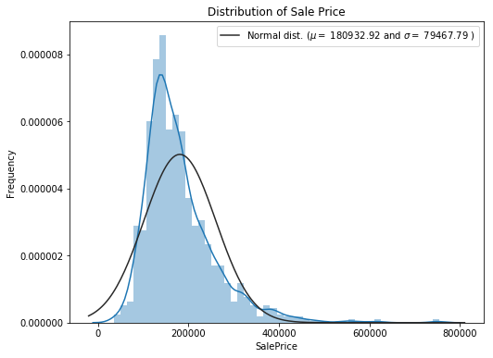
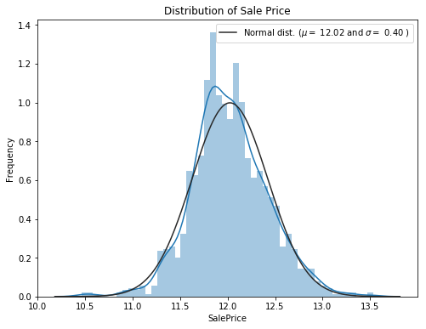
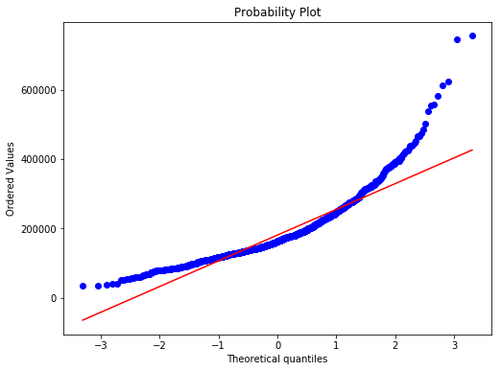
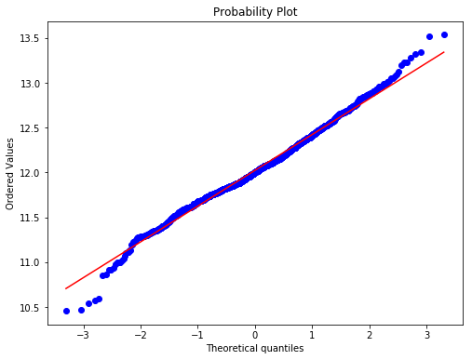
EDA - Distribution
Before log transformation
After log transformation

Slide 10
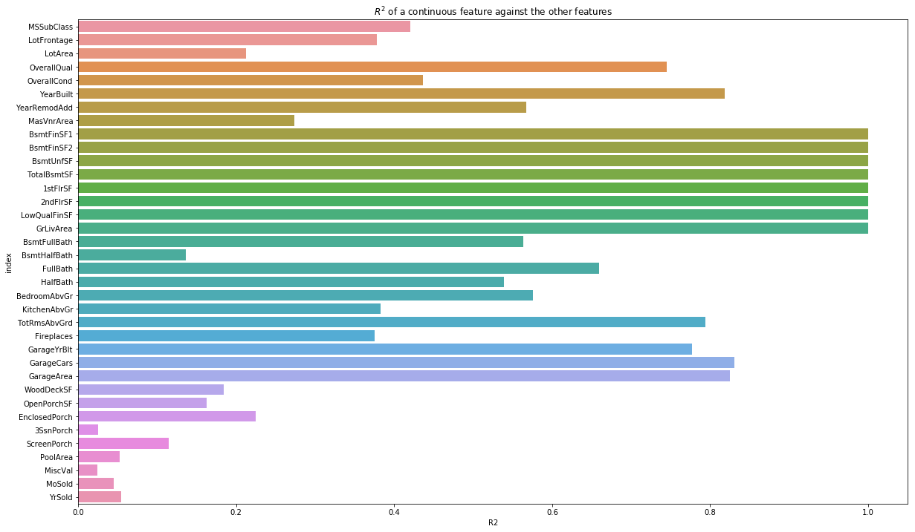
EDA - Multicollinearity
Highly Collinear Features:
BsmtFinSF1
BsmtFinSF2
BsmtUnfSF
TotalBsmtSF
1stFlrSF
2ndFlrSF
LowQualFinSF
GrLivArea
BsmtFullBath
Garage Cars
Garage Area

Slide 11
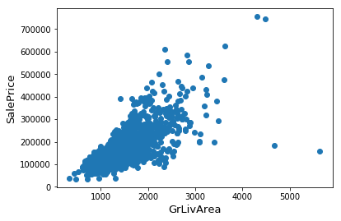
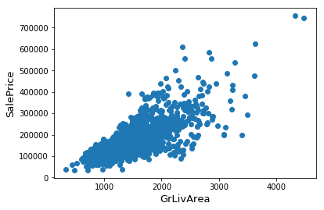
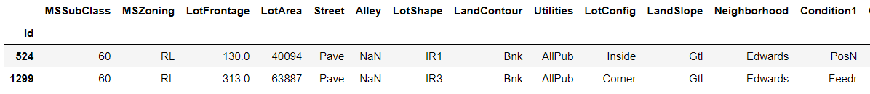
Outliers
Before Removing:
After Removing:

Slide 12
Dummification
Convert 'MSSubClass' nominal column represented by number into categorical data
Dummified all categorical columns
Increase column number from 80 to 261

Slide 13
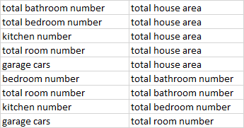
Feature Engineering
Add column that indicates if the house has Basement, Garage, 2nd floor...etc
Increase column from 261 tp 276
Add total square foot, total bathroom number, total full bath, total half bath,total bathroom above ground
Add ratio between some important columns

Slide 14
Feature Engineering - count
Log transformation for columns:
'GrLivArea',
'1stFlrSF',
'LotArea',
'LotFrontage',
'GarageArea',
'BsmtUnfSF'
Adding:
Yearsale = YrSold - YearBuilt
Yearremod = YearRemodAdd - YearBuilt
Remod = booling column depends whether yearremod is 0.

Slide 15
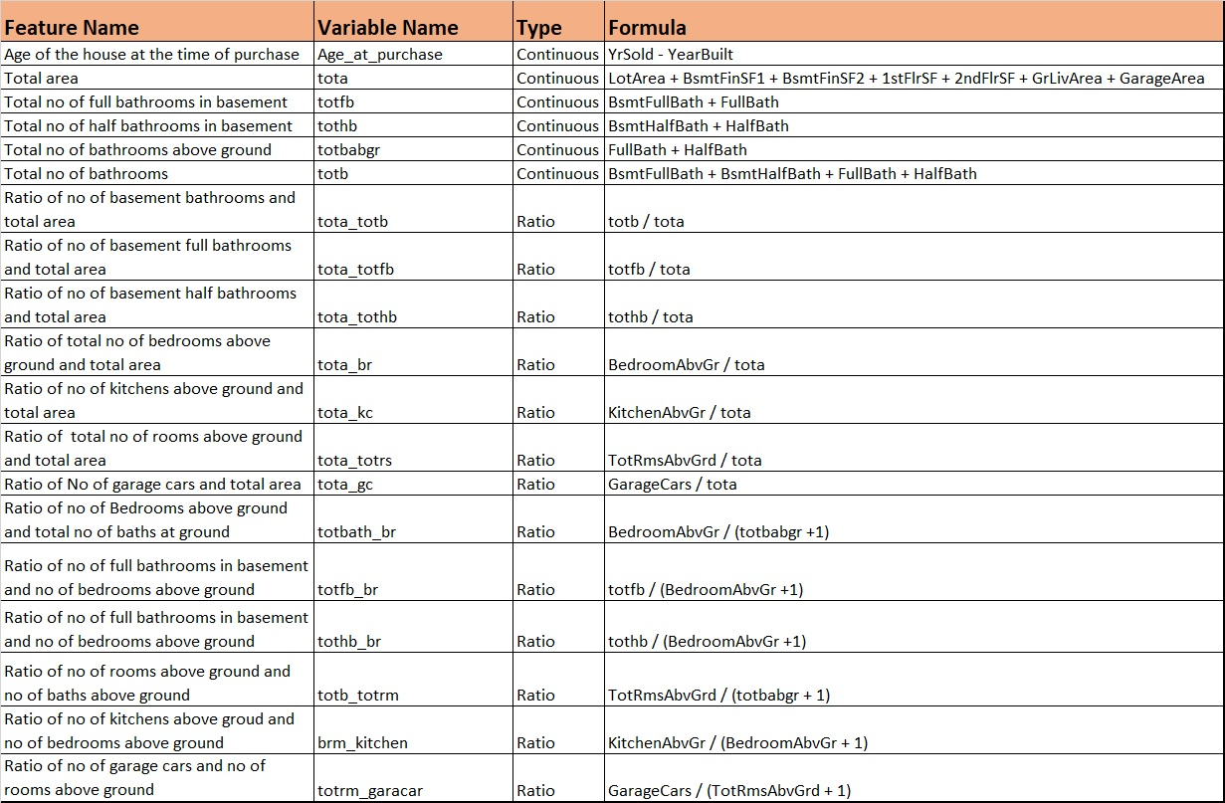

Slide 16
Pre Modeling
Split train data set into train and test data set
Grid search cross validation
Linear Regression:
Ridge
Lasso
eNet
Tree
Basic Tree Model
Random Forest
XGboost
Determine the R^2 score and RMSE or the prediction

Slide 17
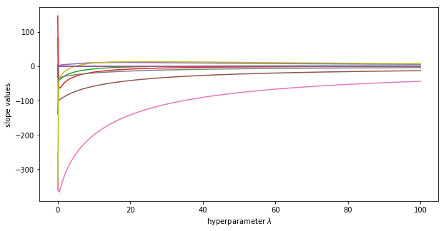
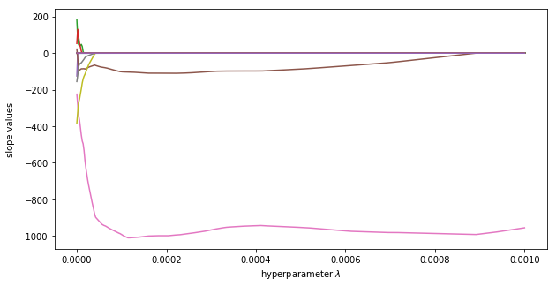
Coefficients of Ridge and Lasso
Ridge, best alpha = 22.222
Lasso, best alpha = 1e-10

Slide 18
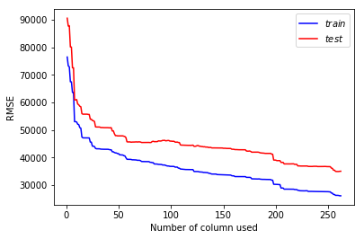
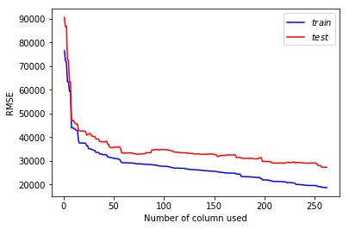
Ridge, Lasso, RMSE vs Model complexity
Ridge:
Lasso

Slide 19
Modeling
Use real test data
Grid search cross validation
Linear Regression:
Ridge
Lasso
eNet
Tree
Random Forest
XGboost
R^2

Slide 20
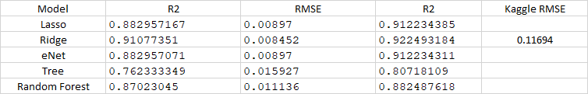
Results:

